Slide 1
Stock Price Prediction in the Presence of High Volatility, Missing Data, and Extreme Events
Evaluating the Performance of Machine Learning Prediction Models and Data Preparation Techniques
Jordan Moshcovitis

Slide 2
Challenges in Stock Price Prediction with High Volatility, Missing Data, and Outliers
Brief Overview:
Addressing challenges in stock price prediction
Exploring the impact of high volatility, missing data, and outliers on time series prediction models
Importance of robustness and risk mitigation
Challenges in stock price prediction:
Impact of external factors (news, economic events, market sentiment)
Noise in high-frequency data
Heteroskedasticity in return distributions
Significance of addressing challenges:
Greater prediction accuracy for trading systems
Robustness to fluctuations in price
Improved risk mitigation
Research objective:
Investigate suitable approach for prediction when there is high volatility missing data and outliers due to extreme events

Slide 3
Research questions
How does high volatility impact the accuracy of machine learning prediction models, and which models are most robust to high volatility, missing data, and outliers?
What are the most effective methods for handling missing data (e.g., linear interpolation, rolling mean) and outliers in stock price prediction with high volatility and extreme events?
How do different pre-processing techniques, such as data imputation or outlier removal, affect the performance of prediction models in volatile stock price data?
How can outlier detection techniques be integrated into the stock price prediction process to enhance model robustness and improve overall predictive performance?
How can relationships between price series be leveraged for improved predictions, including cross-series prediction and exploiting common trends and patterns?

Slide 4
Data Description
Dataset overview:
Source: Unknown (two unnamed price series)
Potential type: Futures data (trading begins early Sunday evening)
Time period: 5 years (2008-2013)
Frequency: 2-minute intervals

Slide 5
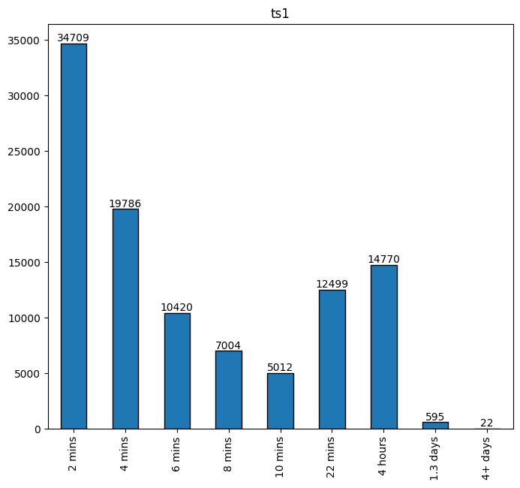
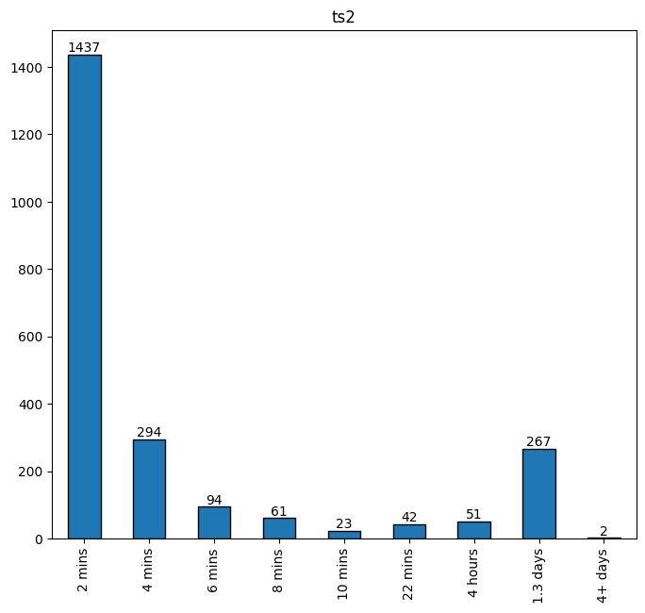
Data Description
Missing values and non-uniform distribution of time gaps
Shorter time gaps more common; longer time gaps less frequent
Presence of outliers (e.g., holidays, market closed days)
Significant number of missing values (not all likely to be holidays)
Wide range of time gaps (Time Series 1: avg. 17.67 min, max. 5,718 min; Time Series 2: avg. 168.24 min, max. 2,838 min)
Skewness in time gap distribution
Long tails indicating significant deviations from expected 2-minute intervals
24-hour price data (excluding Saturdays)
Data irregularities:
Data characteristics:

Slide 6
Exploratory Data Analysis - Seasonality
Characteristics of the data:
Stationary price returns series
ADF test: p-value = 0, stationary time series
KPSS test: p-value = 0.1, stationary around deterministic trend
Nonlinear upwards trend
No seasonal components in hourly, daily, or weekly frequencies
Periodic components in daily and weekly frequencies
Non-normal distributions with heteroskedasticity and volatility clustering
Seasonal decomposition:
Time Series 1 (ts1):
Strong correlation between price and trend
Possible seasonality in monthly time frame
Residuals strongly correlated (underlying structure not captured)
Time Series 2 (ts2):
More likely to be seasonal at higher timescales
Strong upward trend across all timescales
Residuals strongly correlated (underlying structure not captured)
Periodogram analysis:
Both time series show seasonality or periods in intra-day timescale and daily (2 hours, 16 hours, 48 hours)
Significant lags in hourly and daily frequencies indicate serial correlation

Slide 7
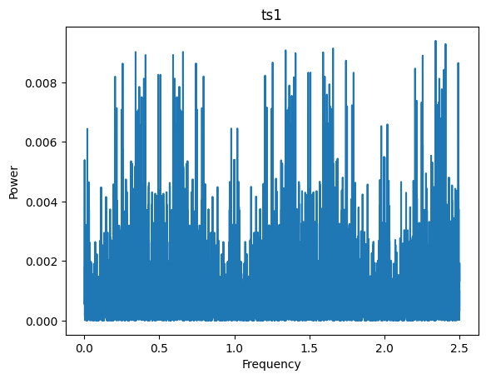
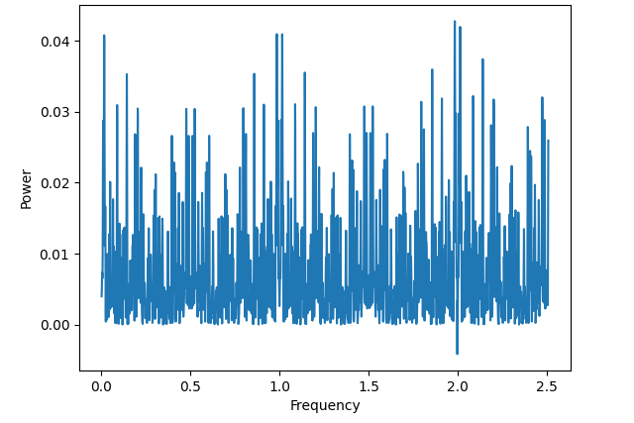
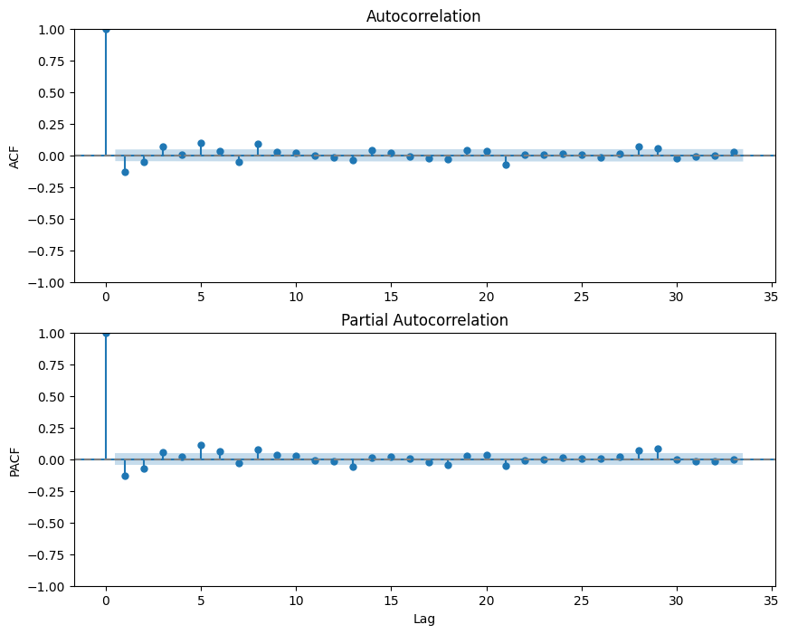
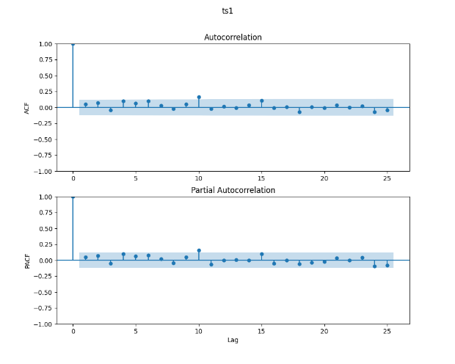
Periodogram and AFC/PCF: Stock 1
Daily
Weekly

Slide 8
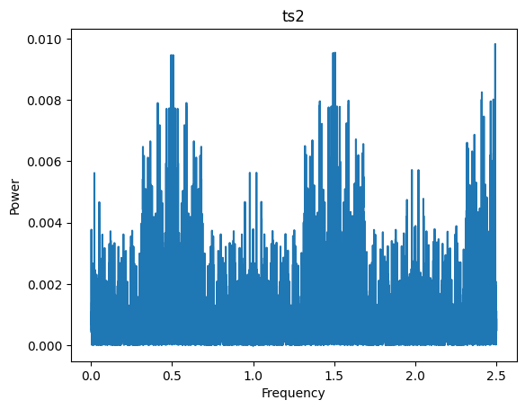
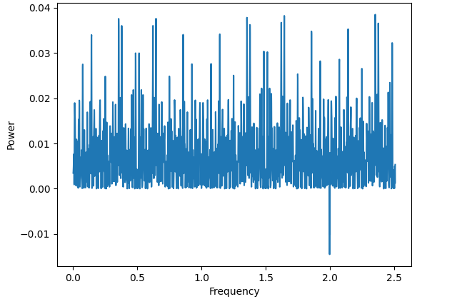
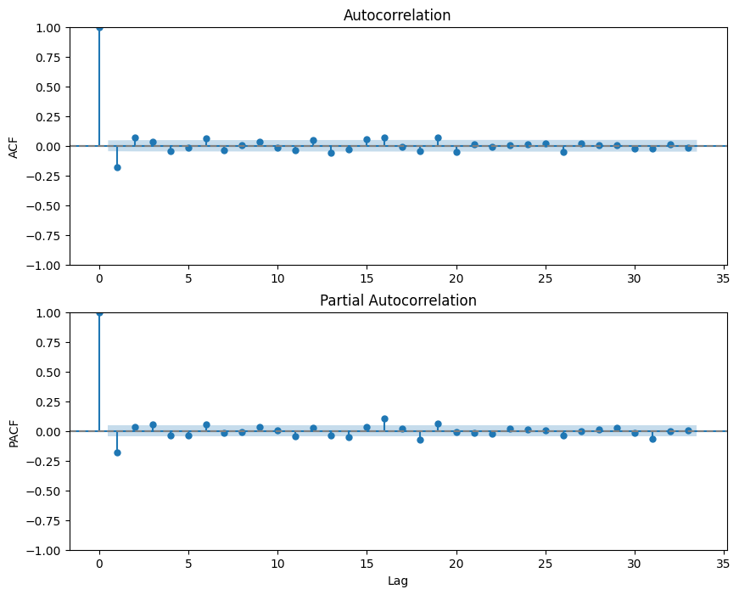
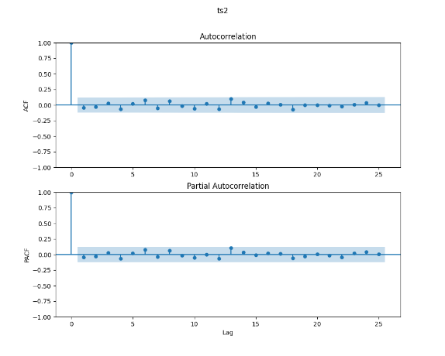
Periodogram and AFC/PCF: Stock 2
Daily
Weekly

Slide 9
Exploratory Data Analysis - Statistics
Key observations:
Extreme market events visually identified
Outliers: Focused on extreme market events (e.g., 2008)
Noise assumed to be inherent in data (not due to measurement error)
Logarithmic returns:
Not normally distributed (Kolmogorov-Smirnov test p-value = 0.0)
Skewness and kurtosis: evidence of non-normality
ts1: skewness ≈ 0, kurtosis = 138.45
ts2: skewness = 0.99, kurtosis significantly different from 3
Mean values close to zero, variances small but different between ts1 and ts2
Covariance between ts1 and ts2: negative, but small magnitude
Non-normal behaviour: heavy tails, high likelihood of extreme values
Rolling mean and standard deviation (window size: 4 hours)
Squared and absolute returns: periods of high volatility
Heteroskedasticity present in time series

Slide 10
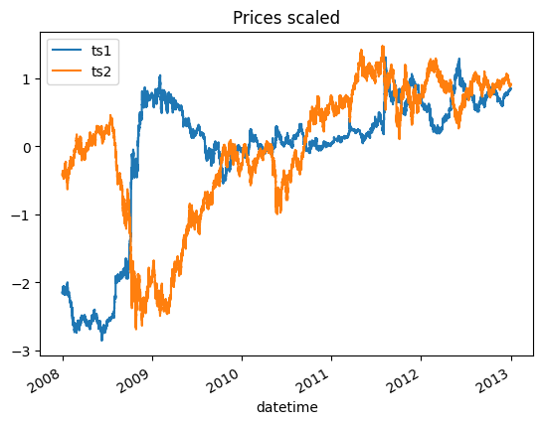
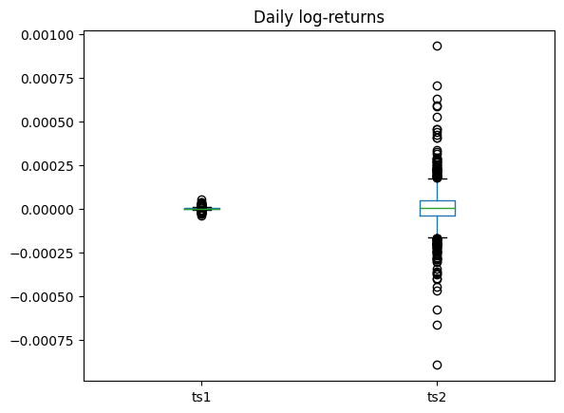
Exploratory Data Analysis - Statistics

Slide 11
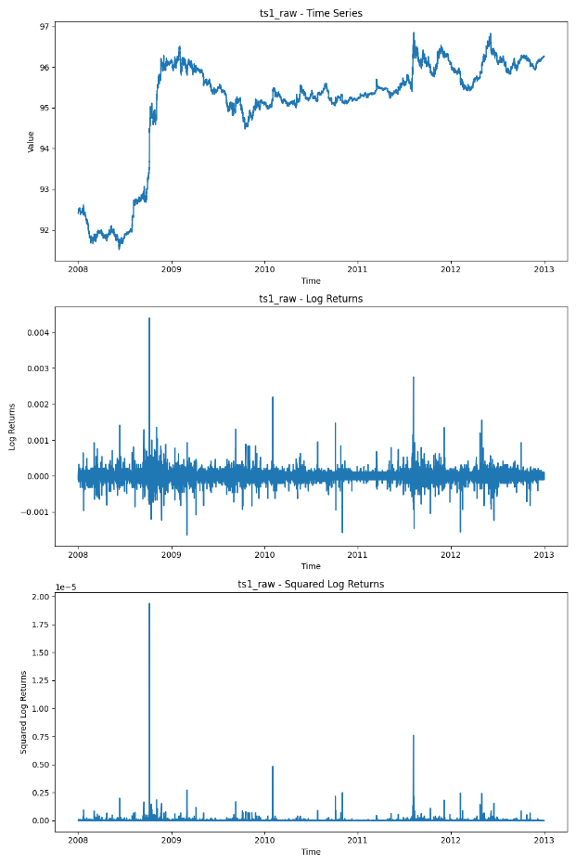
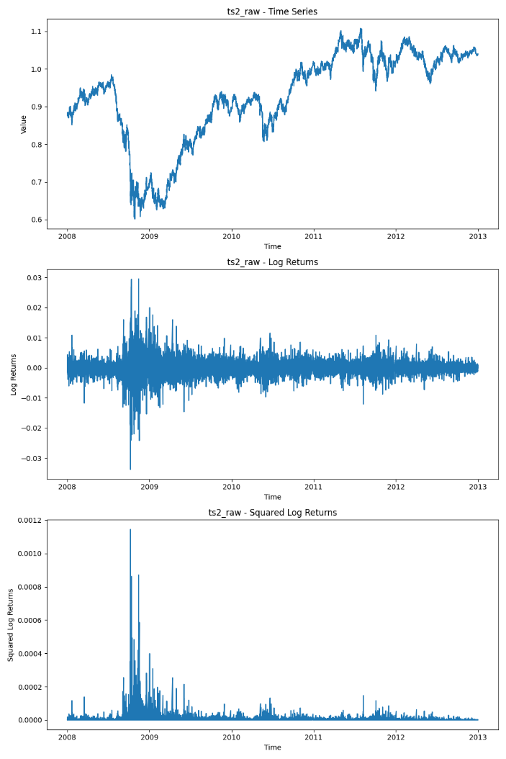
Exploratory Data Analysis - Volatility

Slide 12
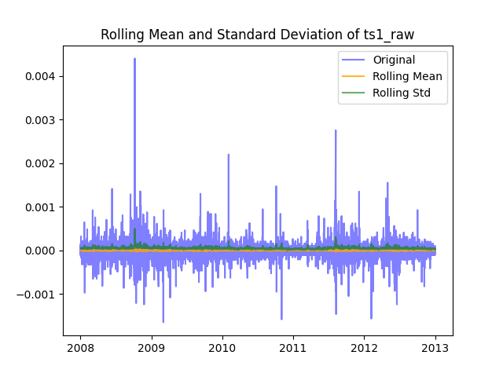
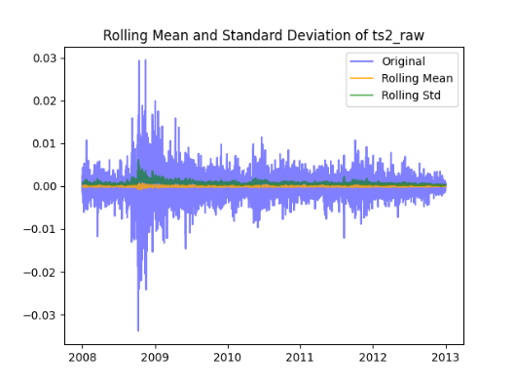
Exploratory Data Analysis - Volatility

Slide 13
Modelling Outline
Research goal: Develop suitable predictions for price returns, accounting for volatility, extreme events, and missing values
Hypotheses:
H1: ts1 can predict ts1
H2: ts2 can predict ts2
H3: ts1 can predict ts2
H4: ts2 can predict ts1
Motivation: Investigate relationships between time series and predictability; impact of imputation and feature engineering on uncertainty
Experiments (4 data preparation methods):
Original data, missing values removed, outliers not identified
Original data, missing values removed, outliers identified
Imputed data, outliers not identified
Imputed data, outliers identified
Model Performance Comparison:
Evaluate models on different dataset versions (original, imputed, with and without outlier identification)
Examine the impact of data imputation and outlier detection techniques on prediction accuracy and model robustness

Slide 14
Methodology - Data Preparation and Pre-processing
Pre-processing steps:
Imputation techniques considered:
Mean imputation
Linear interpolation
Median interpolation
Imputation strategy:
Different methods for short gaps (< 4 hours) and long gaps
Preserve time series structure and stability
Rolling window of 4 hours for moving mean imputation
Resampling:
Hourly
Daily
Data used:
Original data including Saturdays
Linear interpolation:
Least sensitive to underlying volatility
No artificial volatility introduced (unlike mean and median)

Slide 15
Methodology - Data Resampling
Rationale for resampling:
Capture potential daily and weekly periodicities
Reduce uncertainty in true value due to missing values clustering in shorter time frames
Improve computational efficiency
Resampling methods:
Resampled to hourly and daily frequencies
Used mean of the original data for resampling

Slide 16
Methodology - Outlier detection
Extreme market events (e.g., 2008) and sensitivity analysis for model stability and prediction improvement
Non-normality: Tukey fences and modified z-score not robust enough to filter extreme value outliers
Outlier detection:
Based on squared price returns series
Methods compared: Peak over Threshold and DBSCAN clustering
DBSCAN chosen: identifies outliers by cluster size relative to neighbours (epsilon=0.15,min cluster size = 2)
Outlier observations:
Higher number of outliers in first series
Smaller number of common outliers, suggesting stock-specific factors have significant impact

Slide 17
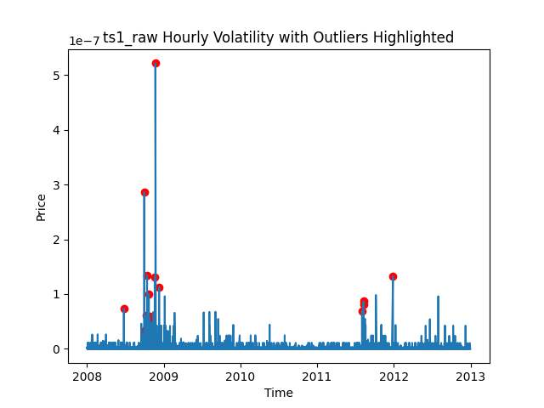
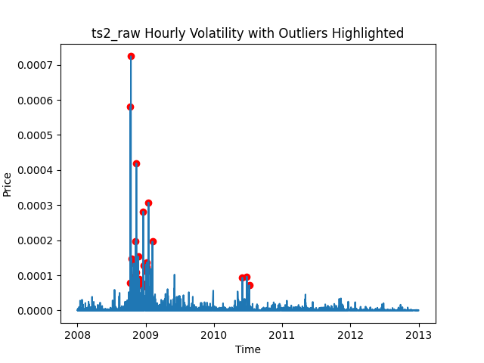
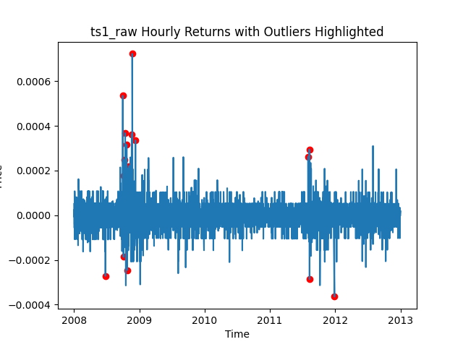
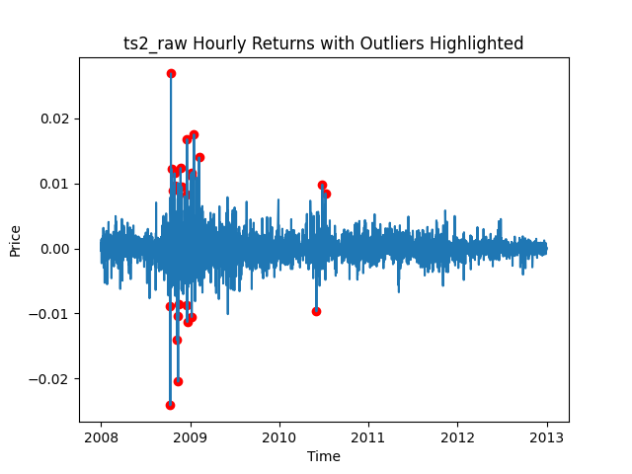
Outlier Detection - Hourly

Slide 18
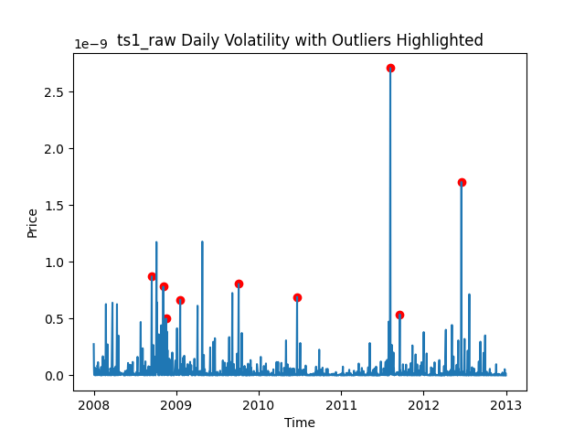
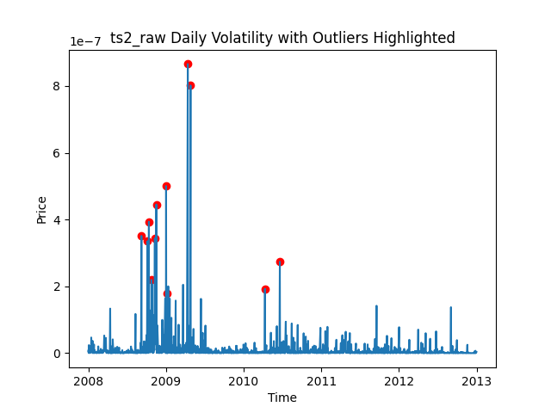
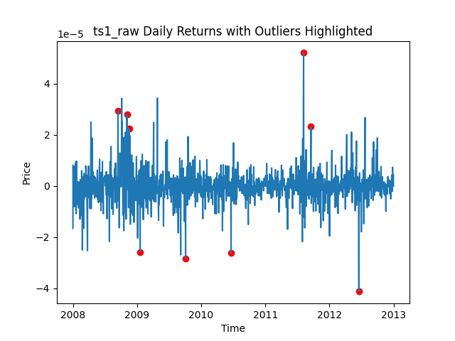
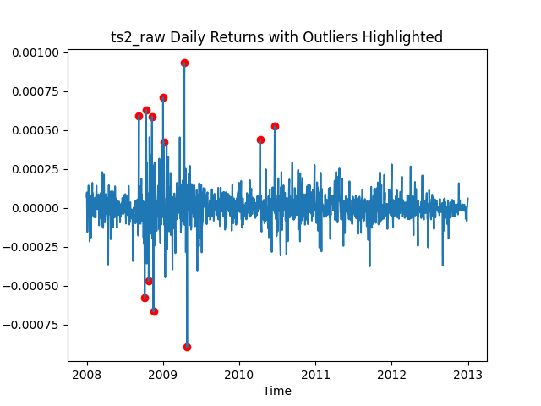
Outlier Detection - Daily

Slide 19
Feature Engineering for Supervised Learning
Data preparation:
Converted to a supervised learning problem using lagged values of the logarithmic price returns
Single-step forecast: target variable is the next time step
Lagged features:
Daily data: 3 lags
Hourly data: 4 lags
One hot encoding outliers
Datetime features: Day of the week, Month, year
Lag chosen from periodogram

Slide 20
Random Walk Simulation as a Benchmark
Random walk :
Simple assumption of price series behaving like a random walk
Used for both univariate (H1H2) and multivariate (H3H4) cases
Simulating unpredictability of stock prices:
Applied using the mean and standard deviation of the returns price series
Captures short-term unpredictability in stock prices
Importance of comparison:
Helps determine if chosen models or modelling approach is appropriate for prediction
Indicates if series is inherently random or has underlying structure/pattern for forecasting purposes
Compare model performance against random walk RMSE
N = 10000 trials

Slide 21
Prediction Models
Chosen prediction models:
KNN clustering
Random Forest
Decision Tree
Gradient Boosting Tree
Light Gradient Boosting Tree
Key characteristics and rationale:
Models chosen that may best handle non-linearity and fat-tailed distribution of price returns
Classical machine learning regression methods as a first approach
Applying models to test hypotheses:
Models will be applied on four versions of the dataset
Evaluating performance and suitability for predicting price returns

Slide 22
Evaluation Metrics and Validation
Evaluation metrics:
Root Mean Squared Error (RMSE)
Appropriate metric to compare different model performance
Train and test sets:
Split at 31-12-2012 (4 years of training data, 1 year of test data)
Cross-validation:
Walk forward window cross-validation with grid search for model tuning and hyperparameter optimization
Optimal number of splits: 30 for sufficient training size and computational limit
Test forecast horizon: 7 days for daily resampled series, 24 hours for hourly resampled series
Prevents overfitting while including sufficient data for training
Retrain the best model found on the complete training set after cross-validation

Slide 23
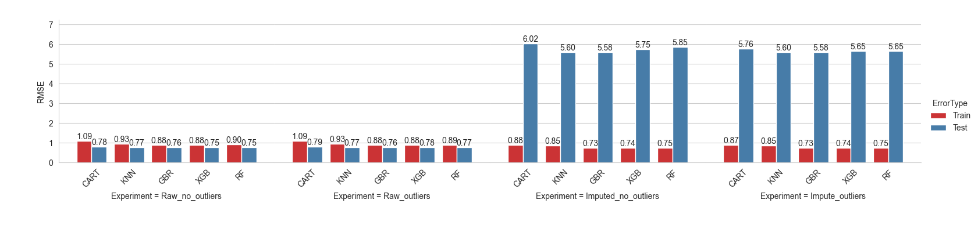
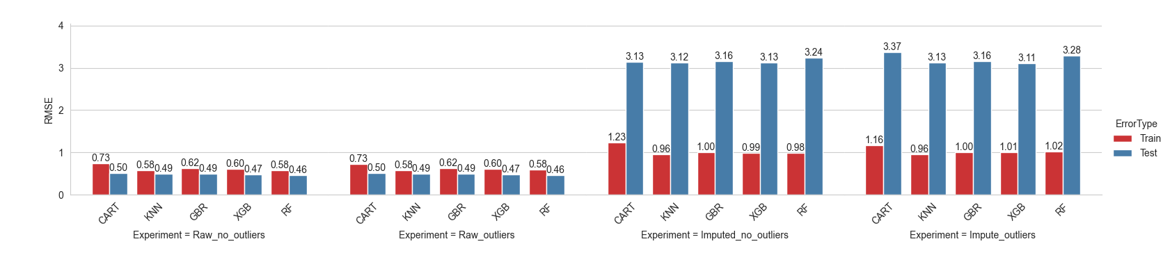
Results – Hypothesis 1 (Hourly)
Train Benchmark RMSE: 1.69
Test Benchmark RMSE: 1.67

Slide 24
Results – Hypothesis 1 (Daily)
Train Benchmark RMSE: 1.71
Test Benchmark RMSE: 1.67

Slide 25

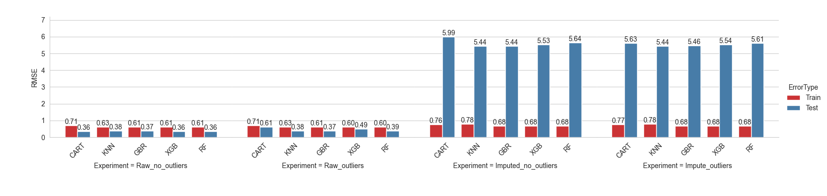
Results – Hypothesis 2 (Hourly)
Train Benchmark RMSE: 0.55
Test Benchmark RMSE: 0.54

Slide 26
Results – Hypothesis 2 (Daily)
Train Benchmark RMSE: 0.55
Test Benchmark RMSE: 0.54

Slide 27
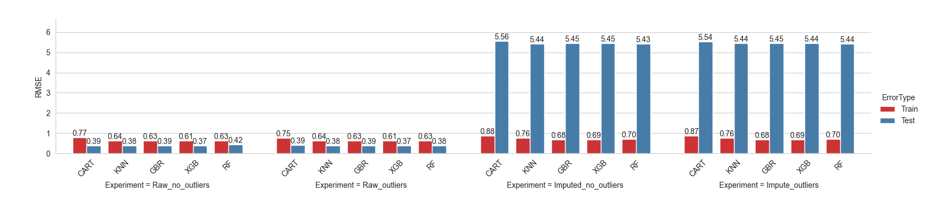
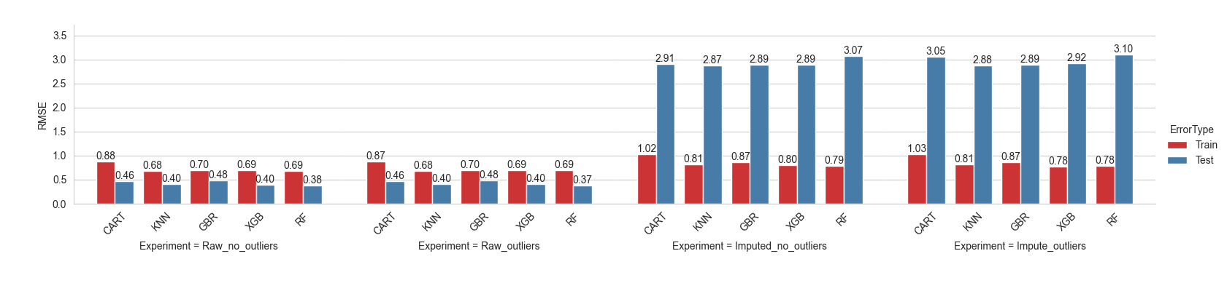
Results – Hypothesis 3 (Hourly)
Train Benchmark RMSE: 0.20
Test Benchmark RMSE: 0.051

Slide 28
Results – Hypothesis 3 (Daily)
Train Benchmark RMSE: 0.23
Test Benchmark RMSE: 0.053

Slide 29
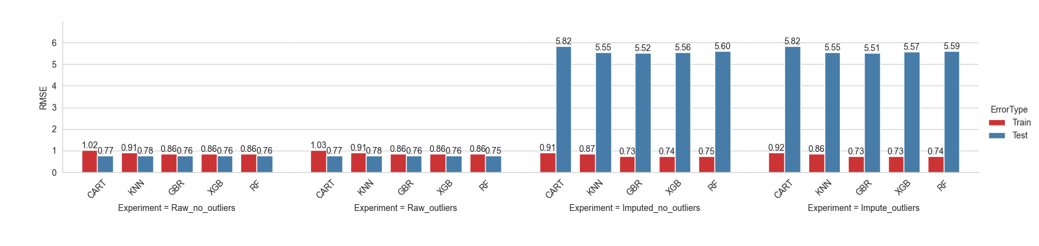
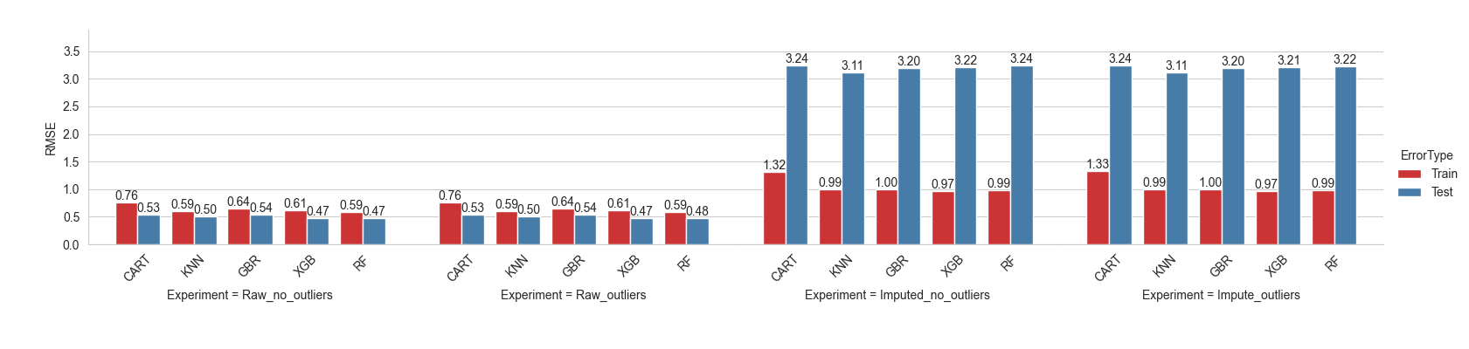
Results – Hypothesis 4 (Hourly)
Train Benchmark RMSE: 1.70
Test Benchmark RMSE: 0.51

Slide 30
Results – Hypothesis 4 (Daily)
Train Benchmark RMSE: 1.74
Test Benchmark RMSE: 0.51

Slide 31
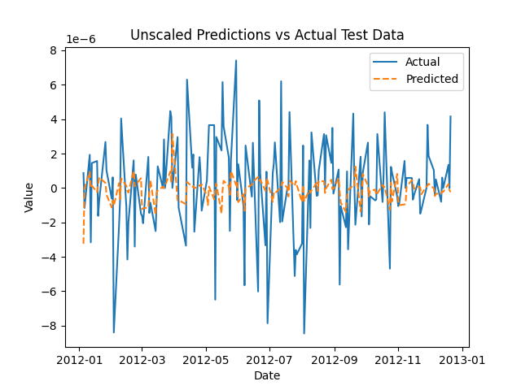
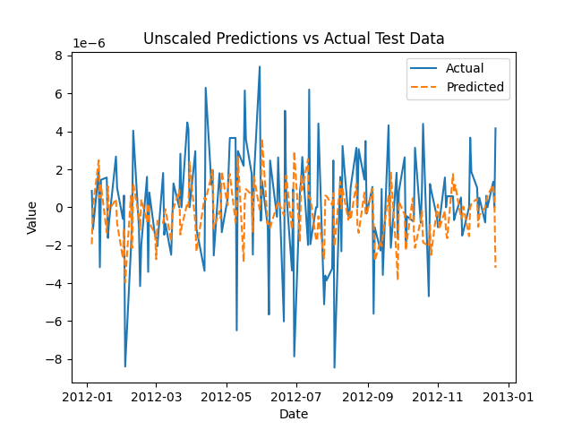
Error validity: H1 (Daily) RF and GBR Comparison
RF showed lower error, but GBR demonstrates greater robustness to volatility
GBR predictions appear lagged, but closer the true price returns volatility than RF
Consider more robust alternatives to RMSE for model evaluation
Random Forest (RF) RMSE: 0.46
Gradient Boosted Regressor (GBR) RMSE: 0.47

Slide 32
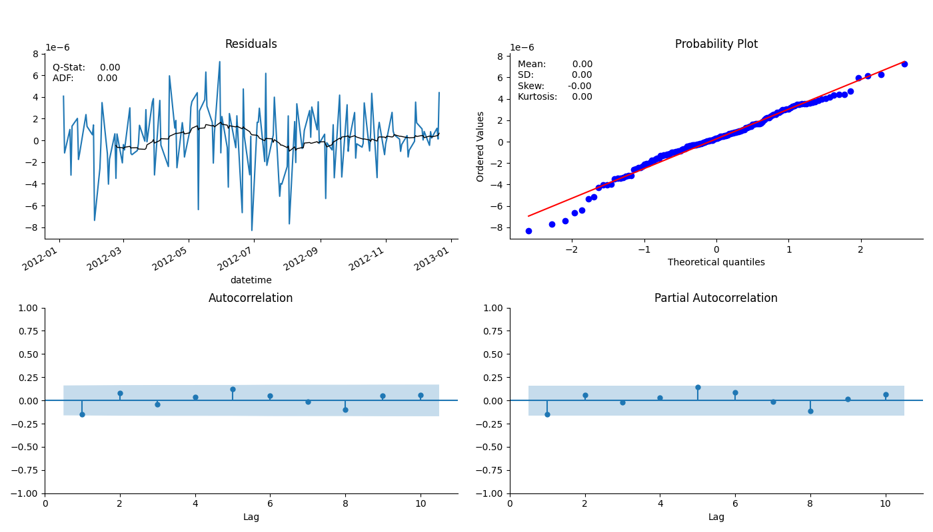

Error validity: RF and GBR H1 Test set (Daily) Residuals
Random Forest (RF) RMSE: 0.46
Gradient Boosted Regressor (GBR) RMSE: 0.47

Slide 33
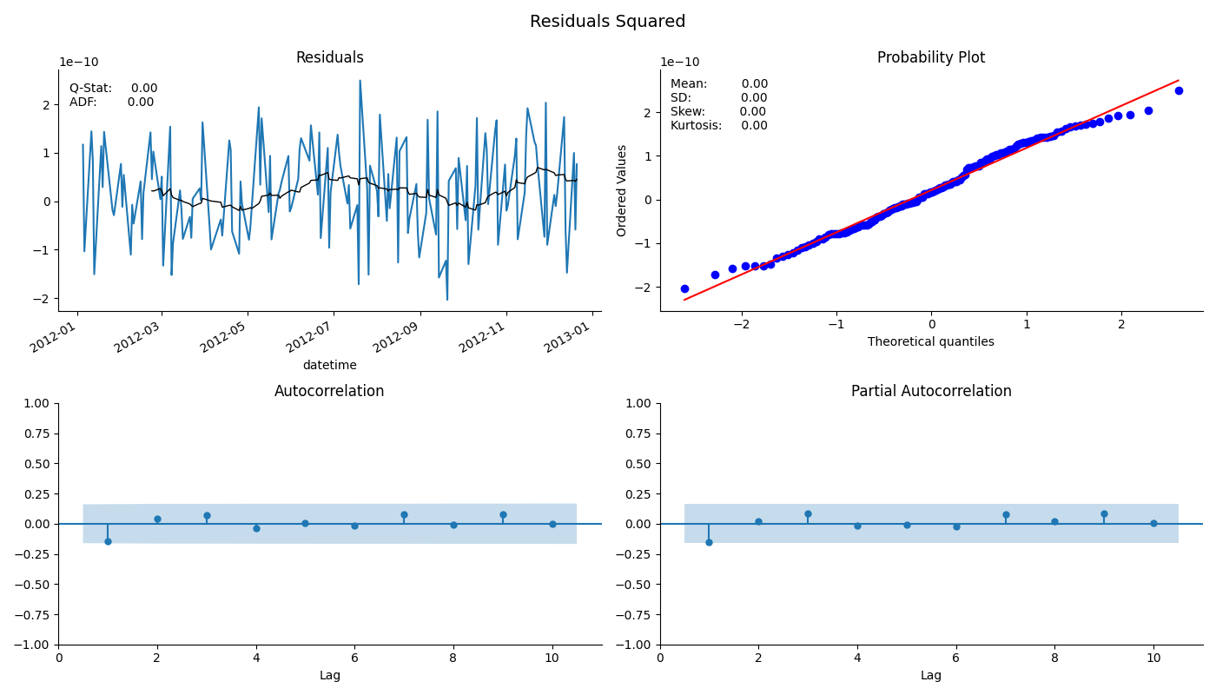
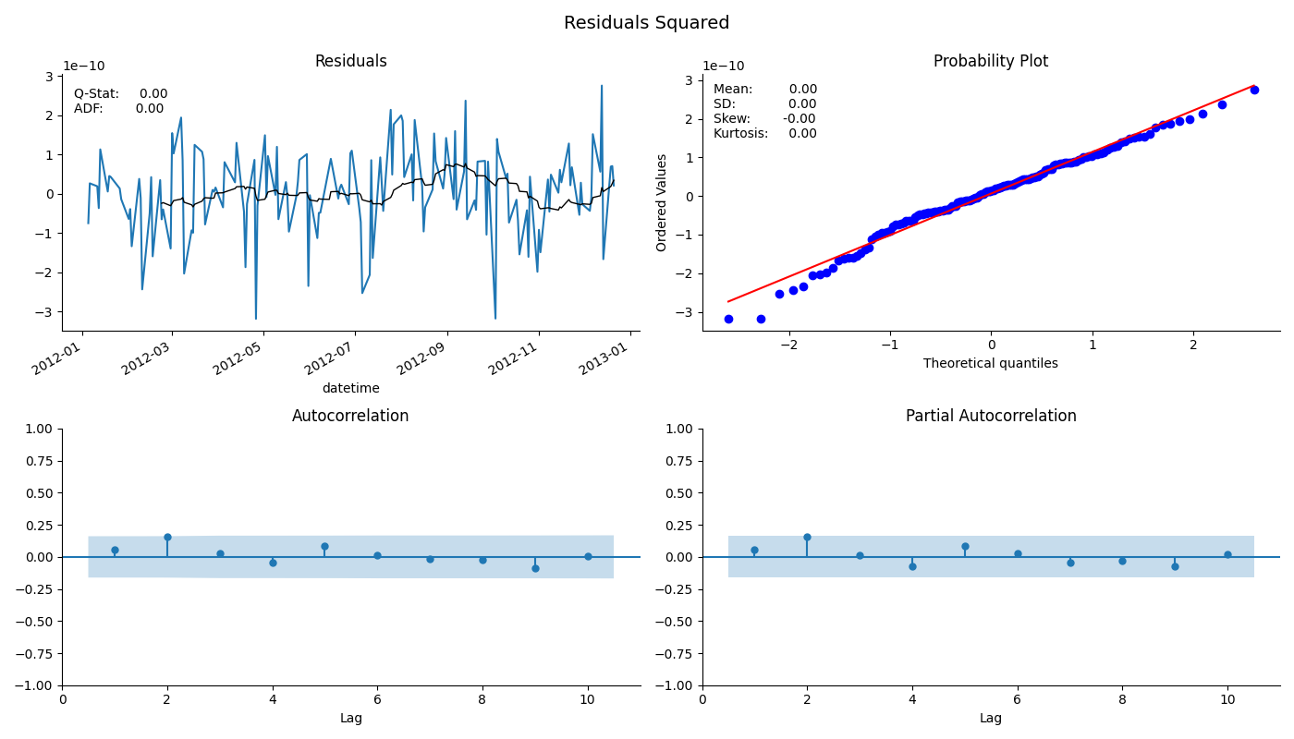
Error validity: RF and GBR H1 Test set (Daily) Residuals Squared
Random Forest (RF) RMSE: 0.46
Gradient Boosted Regressor (GBR) RMSE: 0.47

Slide 34
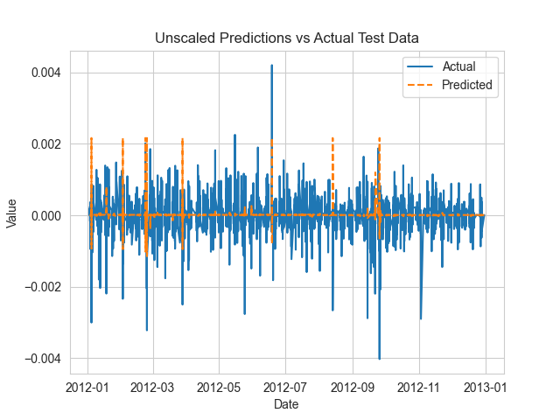
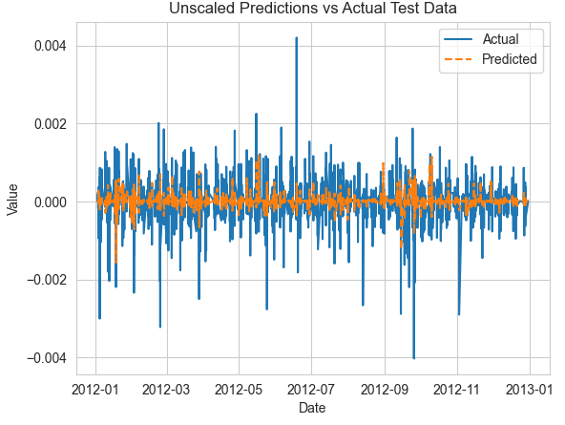
Error validity: H2 (Hourly) RF and GBR Comparison
RF showed lower error, but GBR demonstrates greater ability to account for volatility
GBR predictions do not appear lagged as before, and closer the true price returns volatility than RF
Random Forest (RF) RMSE: 0.39
Gradient Boosted Regressor (GBR) RMSE: 0.37

Slide 35
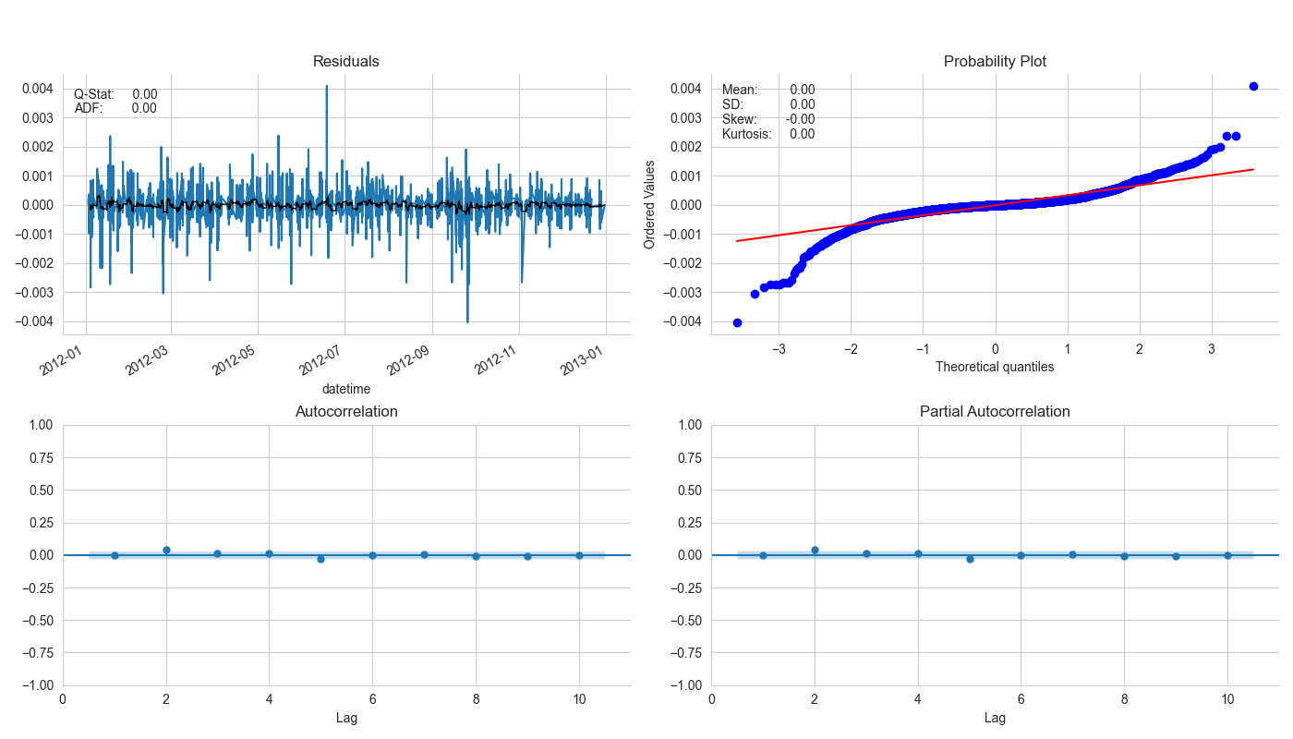
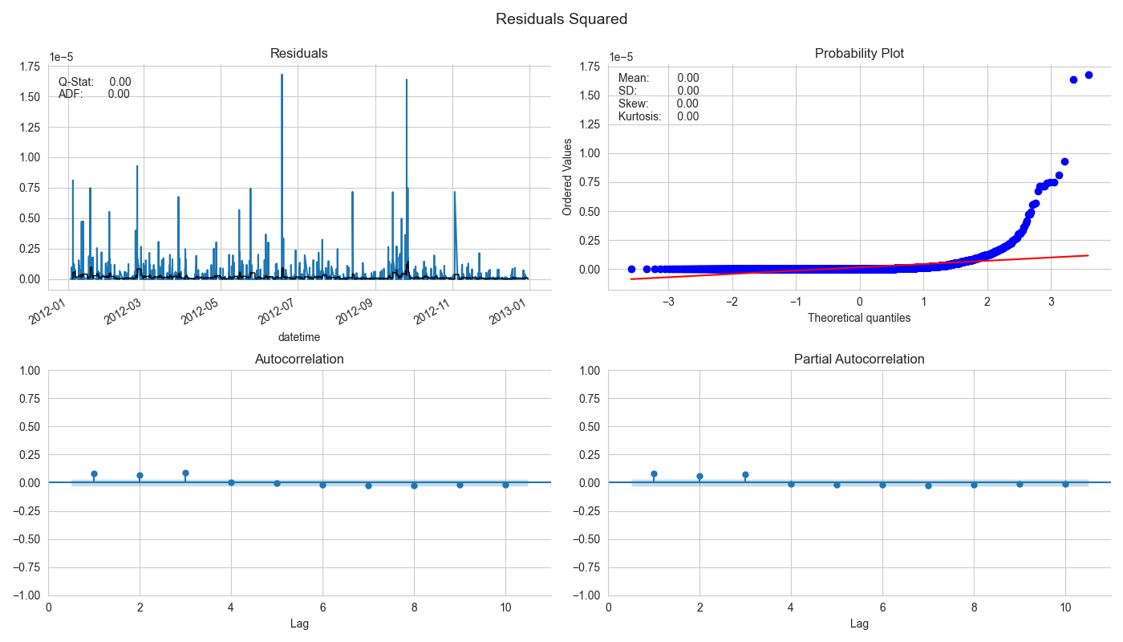
Error validity: RF and GBR H2 Test set (Hourly) Residuals
Gradient Boosted Regressor (GBR) RMSE: 0.37

Slide 36
Discussion
Performance of Prediction Methods in High Volatility and Extreme Events
Ensemble forest methods (e.g., random forests, gradient-boosted trees) outperform simpler decision tree methods in handling high volatility, missing data, and outliers.
Overfitting with imputed data can decrease predictive ability, emphasizing the need for proper model validation and regularization techniques.
Daily resampling proved to categorically provide better predictions on training and test set compared to hourly suggesting that more significant down sampling (24hrs vs 2 mins) may be a suitable approach for minimising the influence of noise in the context of single step predictions
Addressing Heteroskedasticity and Extreme Events
Residual analysis shows that imputation and outlier features did not improve model robustness for heteroskedasticity in the case of hourly sampling
Consider alternative approaches to address heteroskedasticity in future research.
Handling Missing Data, Outliers, and Prediction Challenges
Removing missing values typically yields better performance than imputing missing data.
Including outliers as a feature does not noticeably improve results, suggesting that alternative outlier handling methods may be more effective.
Impact of Pre-processing Techniques on Model Performance
Interpolation can lead to increased error in train and test sets due to overfitting and bias.
Using unimputed data without outliers results in better generalization to the test set.
Autocorrelation in residuals is present in some of the models, as indicated by the Ljung-Box test (p-value < 0.05 in some cases).
Daily sampling showed greater robustness to heteroskedasticity in the reisduals
None of the models have normally distributed residuals, as indicated by the Jarque-Bera test (p-value < 0.05 in all cases).

Slide 37
Discussion
Leveraging Relationships Between Price Series for Prediction
Predicting a stock using its own history is more accurate than using correlations between two stocks (H1H2 vs H3H4)
Further research is needed to explore the potential benefits and limitations of cross-series prediction.
Benchmarks
Most models exhibited larger errors than the benchmark random walk, indicating the need for further investigation into alternative models or feature engineering techniques.
Comparing Data Imputation Techniques
Artificially synthesizing data (e.g., interpolation) can reduce predictive ability and propagate bias in outlier features.
Consider evaluating alternative imputation techniques, such as rolling mean.
Integrating Outlier Detection Techniques for Enhanced Robustness
Future research should explore other outlier detection methods (e.g., statistical tests, clustering, deep learning-based techniques) for integration into the stock price prediction process.
For the non-imputed data, the outlier feature showed the identification of extreme events can improve model prediction

Slide 38
Conclusion and Future Research
Conclusion and Future Research
The Random Forest model demonstrated the best performance in terms of RMSE, but it is crucial to consider other factors such as model complexity, interpretability, and generalization ability.
Model performance should be validated using additional test datasets or cross-validation techniques to ensure robustness and reliability.
More testing is needed to identify models and features that can account for correlation, volatility, and provide good forecasting ability with robustness to extreme events.
Investigate the potential of other models, feature engineering techniques, and evaluation metrics in the context of stock price prediction with high volatility and extreme events.
Limitations of the study:
Data limitations
Model assumptions

Slide 39
Future Research Avenues:
Missing values:
Kalman filter
Time-weighted imputation
Cluster methods
Distribution-based imputation
Outlier detection:
Local order factor
Autoencoder
Explore other prediction models:
Regime-switching models (Markov-switching, hidden Markov models)
Wavelet-based methods
Bayesian methods (Bayesian hierarchical models, Bayesian state-space models, Gaussian process regression)
Adapt existing prediction methods or develop new ones for high-frequency data, extreme events, and non-normal return distributions
Investigate the role of data granularity:
Impact on prediction method performance
Limitations of one-step forecasting for high-frequency or low-frequency data

